Slide 1
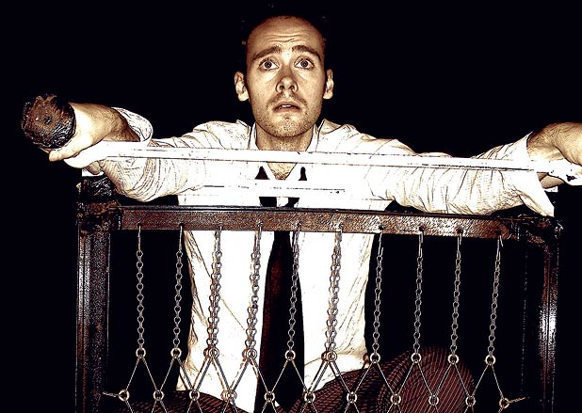
PHYSICAL THEATRE
Year 8 Drama
Lesson 2
Using Skills & Techniques

Slide 2
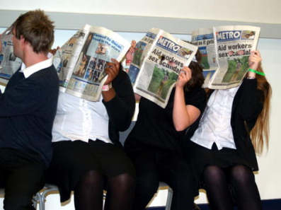
LESSON OBJECTIVE:
Lesson Objective:
To create images considering the use of pace, rhythm, movement and sound
To understand how to perform a piece of physical theatre.
To create images considering the use of pace, rhythm, movement and sound

Slide 3
KEYWORDS
Lesson Objective:
To create images considering the use of pace, rhythm, movement and sound
To understand how to perform a piece of physical theatre.
Physical Theatre
Sound Effects

Slide 4
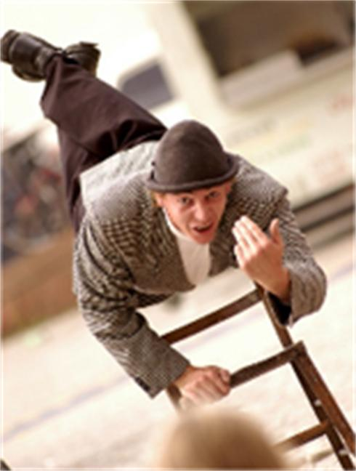
What skills did we learn in the previous lesson
Lesson Objective:
To create images considering the use of pace, rhythm, movement and sound
To understand how to perform a piece of physical theatre.
Achievement points awarded to students who remember.
There are 8 answers:
Body tension
Control
Physical Strength
Mime
Focus
Ensemble
Trust
Good ‘eye’ Contact

Slide 5
CREATING A MACHINE
Lesson Objective:
To create images considering the use of pace, rhythm, movement and sound
To understand how to perform a piece of physical theatre.
X_XX_XXX_XX_X_XX_XXX_XX_X_XX_XXX_XX_X_XX_XXX_XX_X
As a class, clap this rhythm until everyone has grasped it.
How could we use this clapping rhythm to help us present objects?
e.g. washing machine, microwave, train, etc

Slide 6
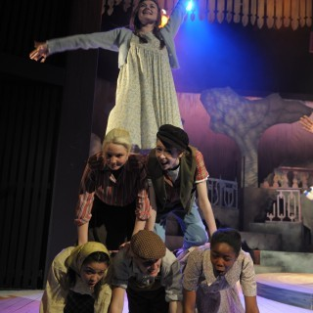
4 GROUPS
Lesson Objective:
To create images considering the use of pace, rhythm, movement and sound
To understand how to perform a piece of physical theatre.
Split class into 4 groups:
Clap fast like an express train
Clap quite fast like a normal train
Clap medium speed like a bus
Clap slow like a horse and carriage
2 MINS TO REHEARSE AS A GROUP
Present to the class.
How can we relate this exercise to what machines are like?
Pace, rhythm, repetition, sound

Slide 7
Machine Making
Lesson Objective:
To create images considering the use of pace, rhythm, movement and sound
To understand how to perform a piece of physical theatre.
Decide what machine you are
Consider the noises that it makes
Make sure all movements are mechanical/ machine like
Consider different rhythms and speeds
In groups of 5/6 students decide on a machine that the group will create using their bodies (help cards available if students struggle) BE CREATIVE!
e.g. TENNIS BALL MAKING MACHINE
WASHING MACHINE
MICROWAVE
POPCORN MAKING MACHINE

Slide 8
Machine Making
Lesson Objective:
To create images considering the use of pace, rhythm, movement and sound
To understand how to perform a piece of physical theatre.
In groups of 5/6 students decide on a machine that the group will create using their bodies (help cards available if students struggle) BE CREATIVE!
e.g. TENNIS BALL MAKING MACHINE
WASHING MACHINE
MICROWAVE
POPCORN MAKING MACHINE
Decide what machine you are
Consider the noises that it makes
Make sure all movements are mechanical/ machine like
Consider different rhythms and speeds

Slide 9
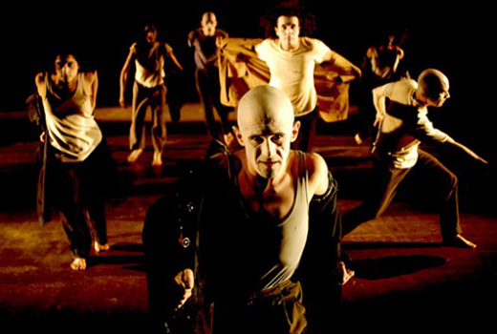
Mid Performance
Lesson Objective:
To create images considering the use of pace, rhythm, movement and sound
To understand how to perform a piece of physical theatre.
1 group to perform.
What machine were they being?
How do we know this?
How could their machine be improved?

Slide 10
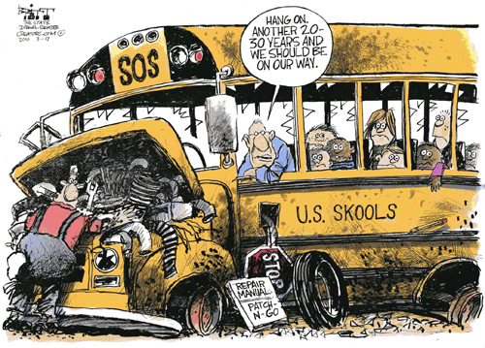
Machine Breakdown
Lesson Objective:
To create images considering the use of pace, rhythm, movement and sound
To understand how to perform a piece of physical theatre.
Students rehearse their machine again adding in the suggested improvements.
IN ADDITION STUDENTS MUST MAKE ONE CHANGE TO THEIR MACHINE
One part may break or overheat
The machine may get faster or slower
The audience needs to see the machine working normally and then the change will occur.

Slide 11
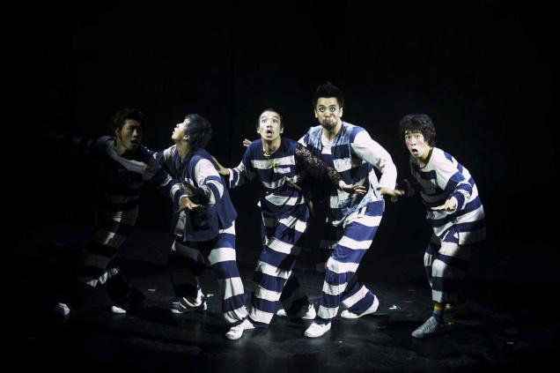
Performance
Lesson Objective:
To create images considering the use of pace, rhythm, movement and sound
To understand how to perform a piece of physical theatre.
Teacher choose 2 or 3 groups to perform to the class
What machines were they?
How did we know this?
What skills did you see the students using?

Slide 12
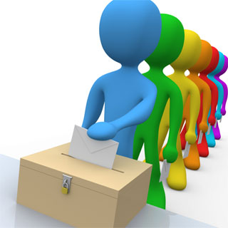
VOTING
Lesson Objective:
To create images considering the use of pace, rhythm, movement and sound
To understand how to perform a piece of physical theatre.
Students vote for the best setting or machine (close eyes and hands up to vote when Teacher calls each group out)
Winning group gets Achievement points

